Slide 1
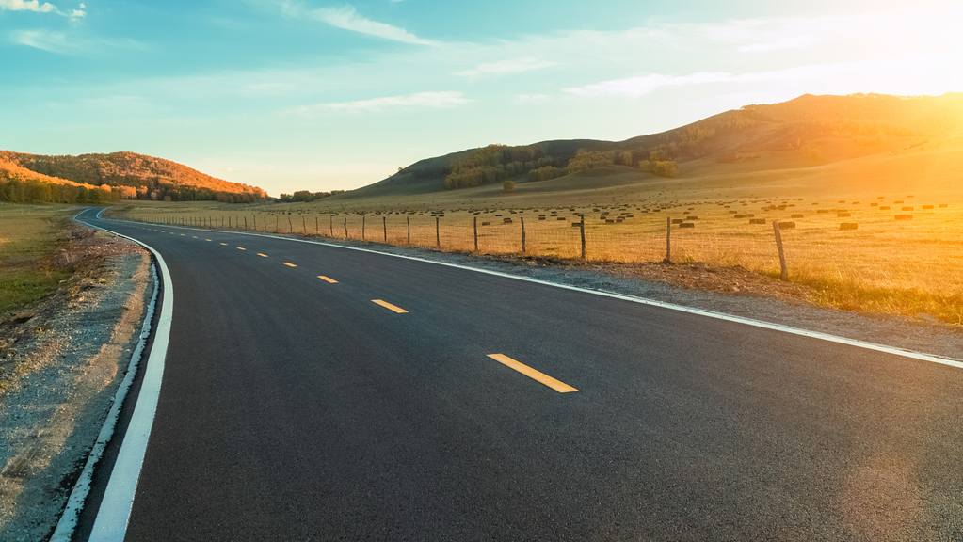

Tick Tock Taxies
Excellence And Beyond

Slide 2
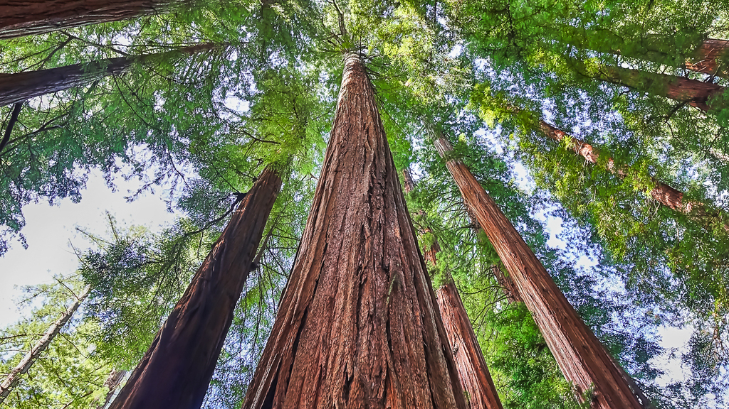
Service
Topic:- Transportation Problem Focused on:- Lack of Public transport using sustainable energy
Main feature of the project:- Use of Electrical vehicles, Solar charging and safety on the cars. Use of Bio-Gas in cars
Team Members
Vybhav Manoj Kumar
vybhavm17@gmail.com
Phone:-
Sam Abdul Latheef
staticsam01@gmail.com
+971 50 828 2440
Team Members
Hrishinath Manoj Pillai
hrishinathp@gmail.com
Phone:-
Sai Satwik Godena
saisatwikgodena@gmail.com
+971 55 244 6970
car
Team name
Debug Entity

Slide 3
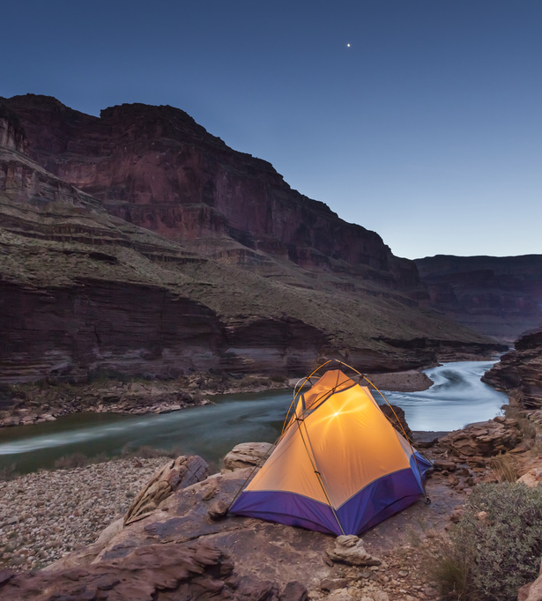
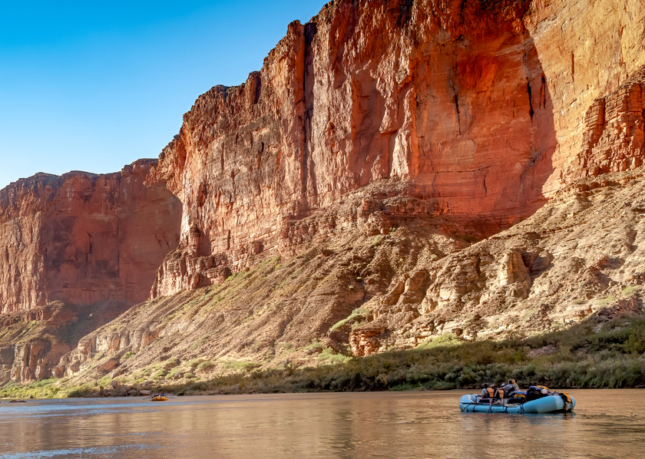
Travel to almost any where and any time. Book now!

Slide 4
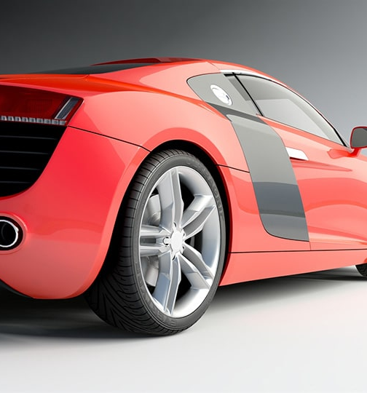
TRAVEL IN LUXURY AND STYLE

Slide 5

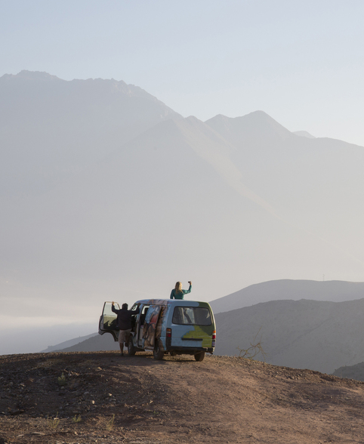

Make your Journey the best with Tick Tock Taxis

Slide 6
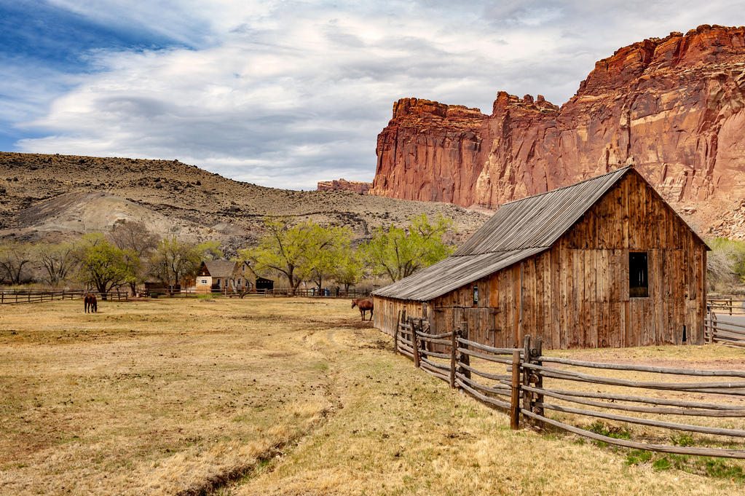


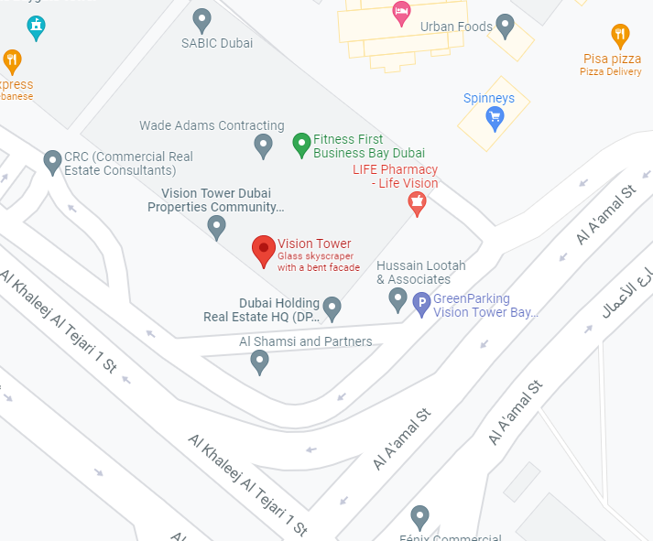
Road
hit the
Call Us Right Now!

Slide 7





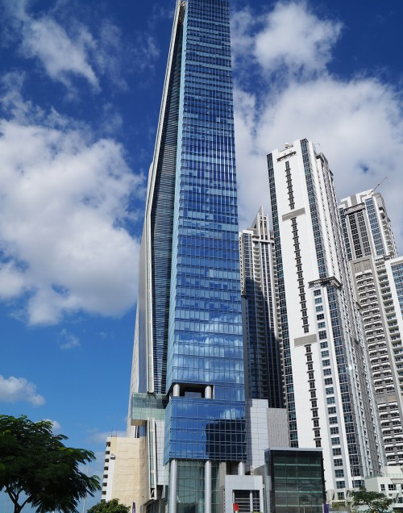
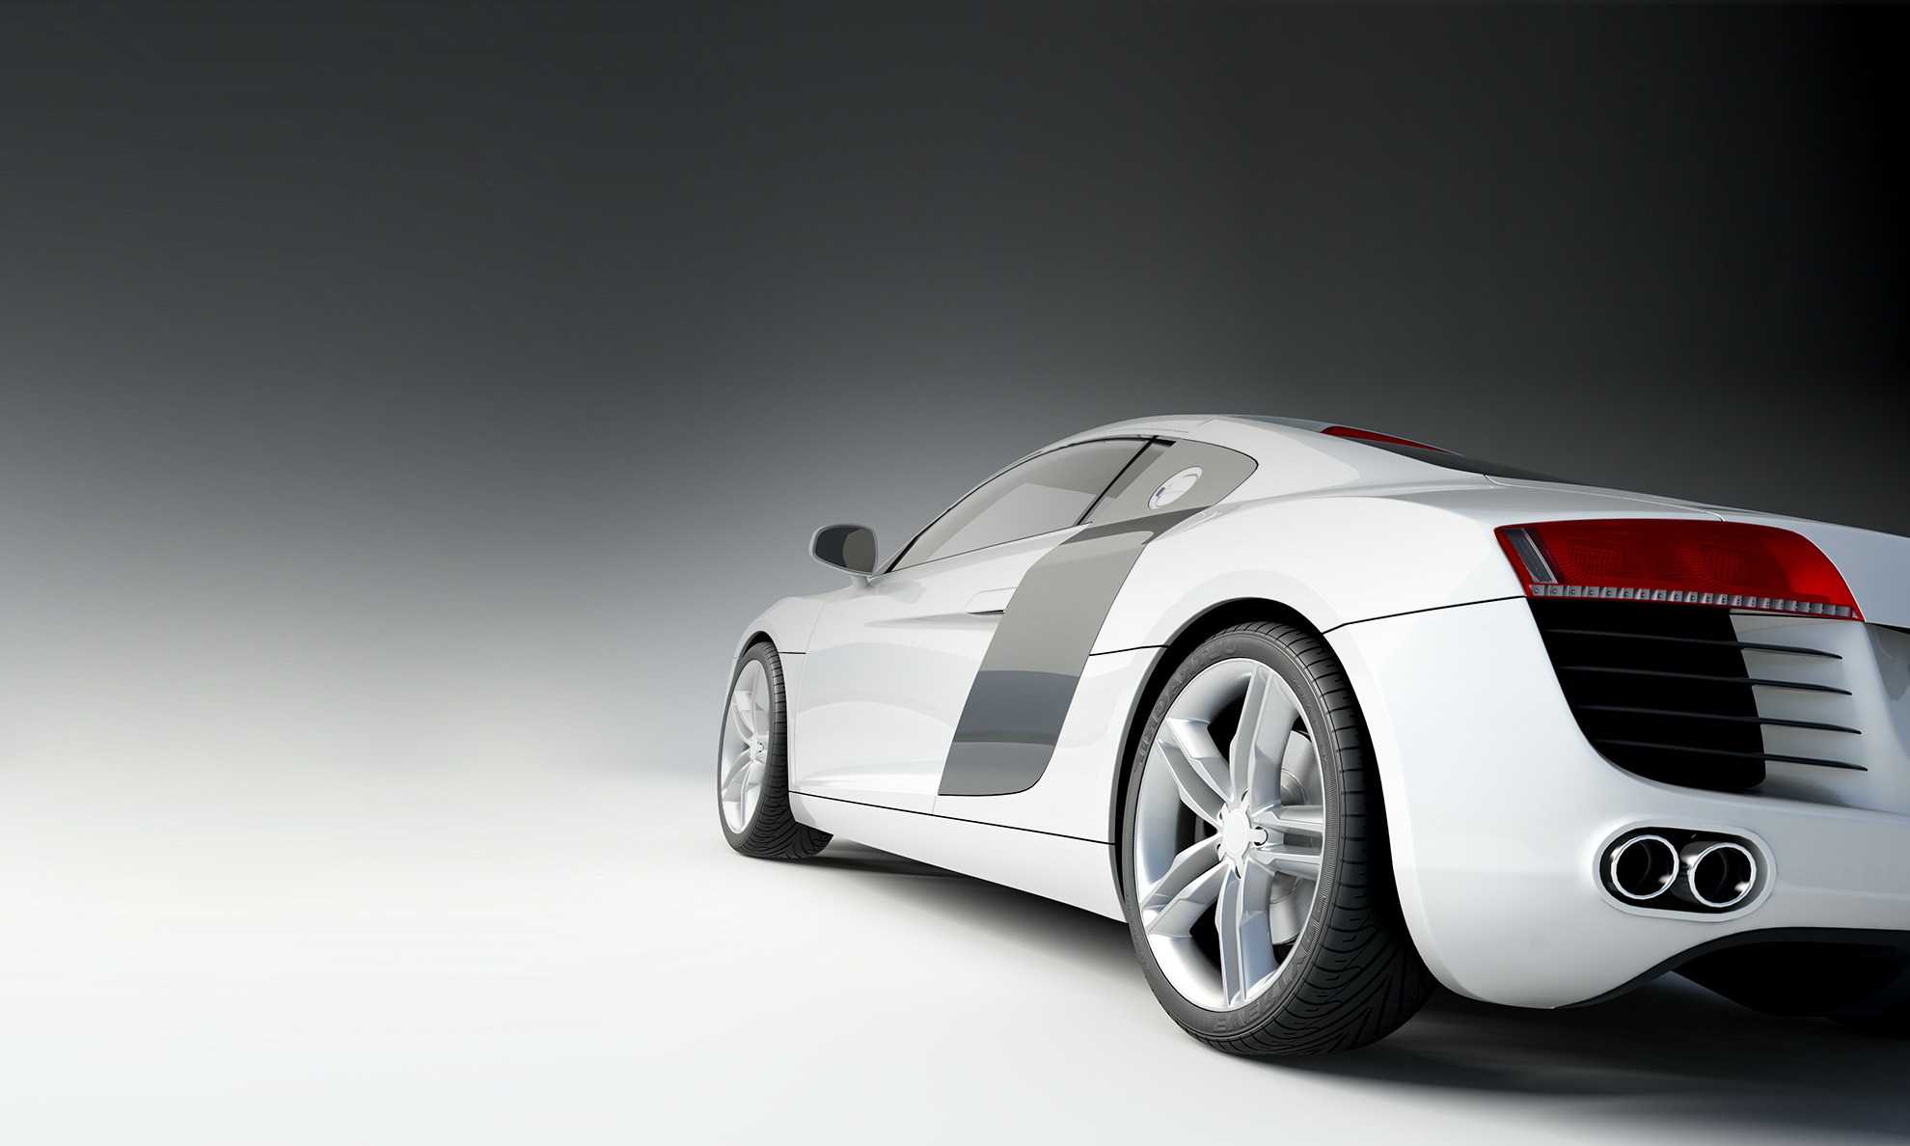
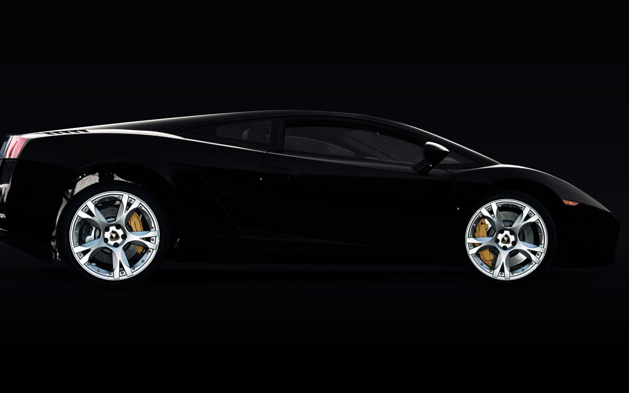
Slide title 7

Slide 8

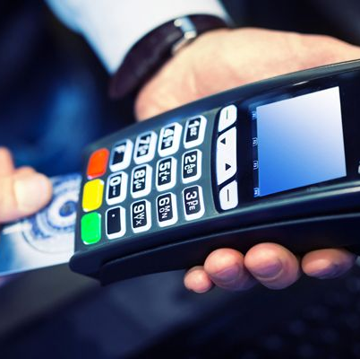
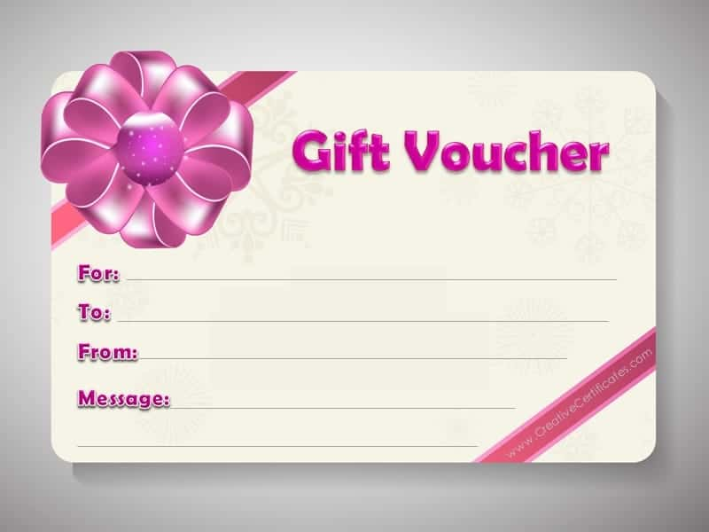

Payment
Method of
All of the below methods are acceptable for payment

Slide 9
Judges
Next Is For the

Slide 10
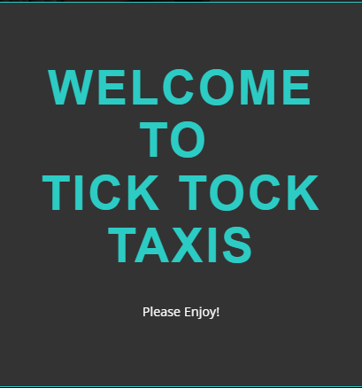
Welcoming Designs at startup

Slide 11
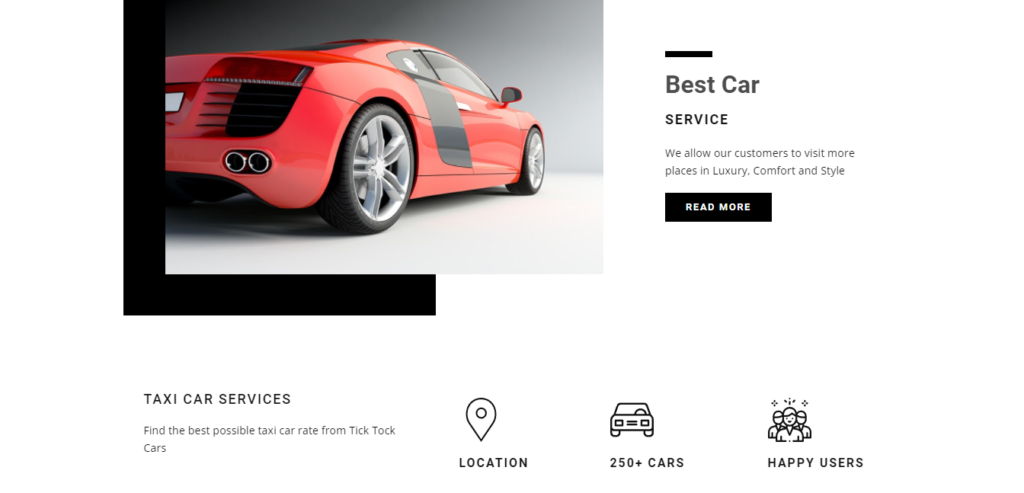
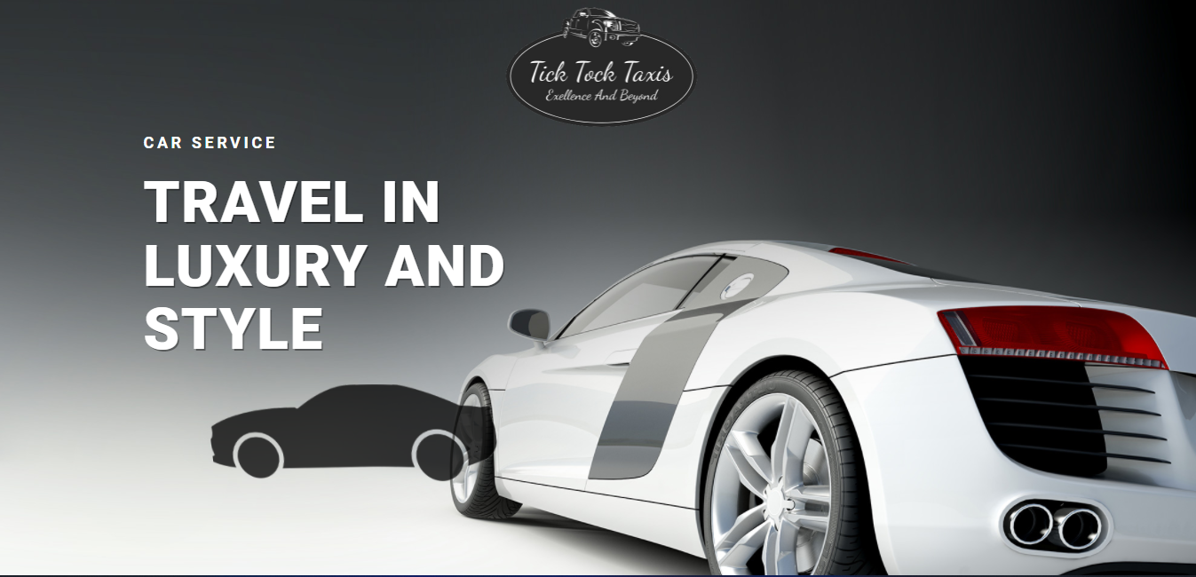
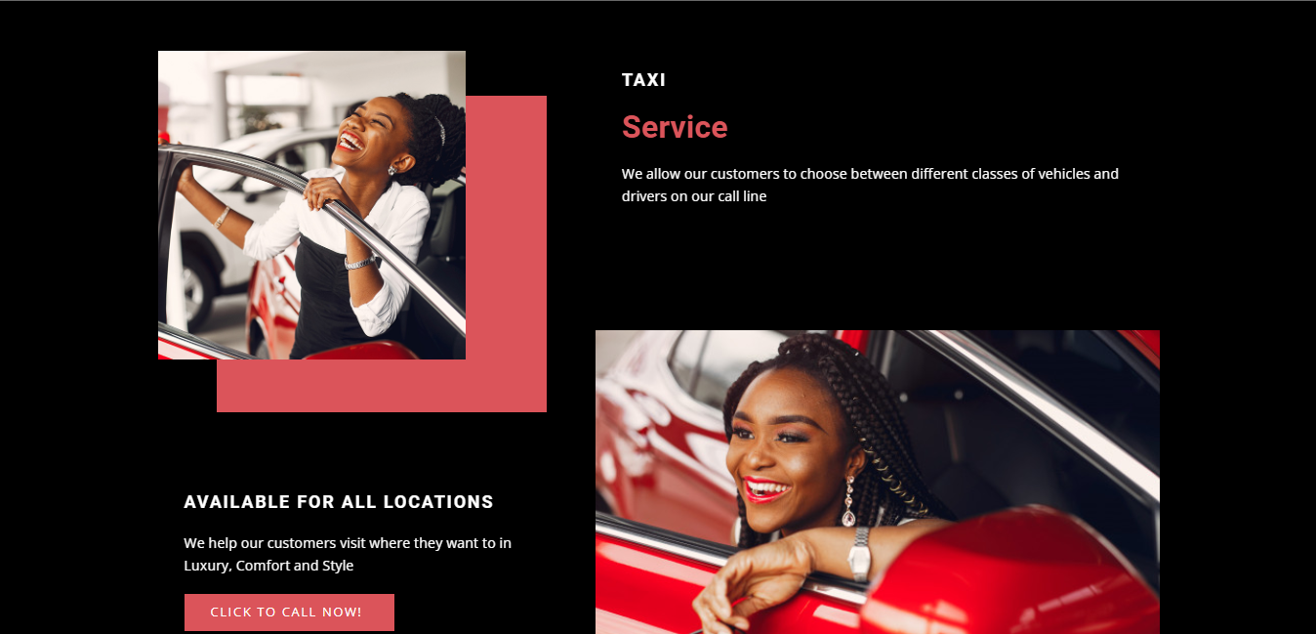
Made the Entire Website only with HTML, CSS and Java Script.

Slide 12


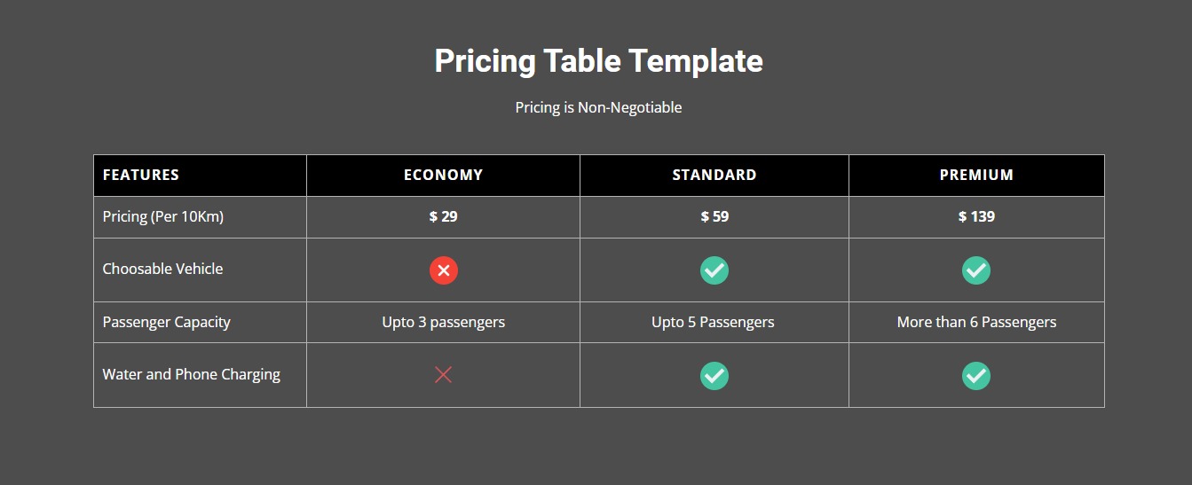
You can view and read more about our services.

Slide 13
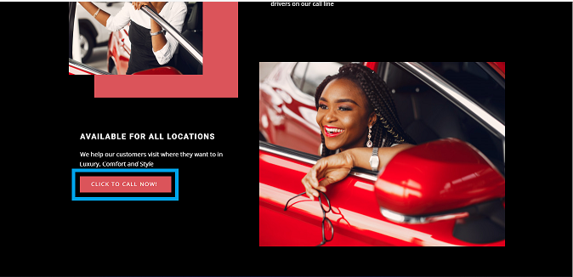
You can call us through the given phone number (Dear Judges, kindly note this is a fake number just taken as an example)

Slide 14
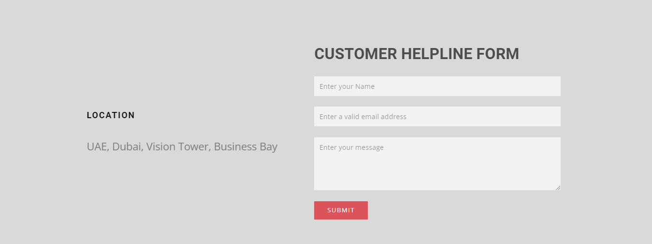
We Accept reviews from our Customers

Slide 15
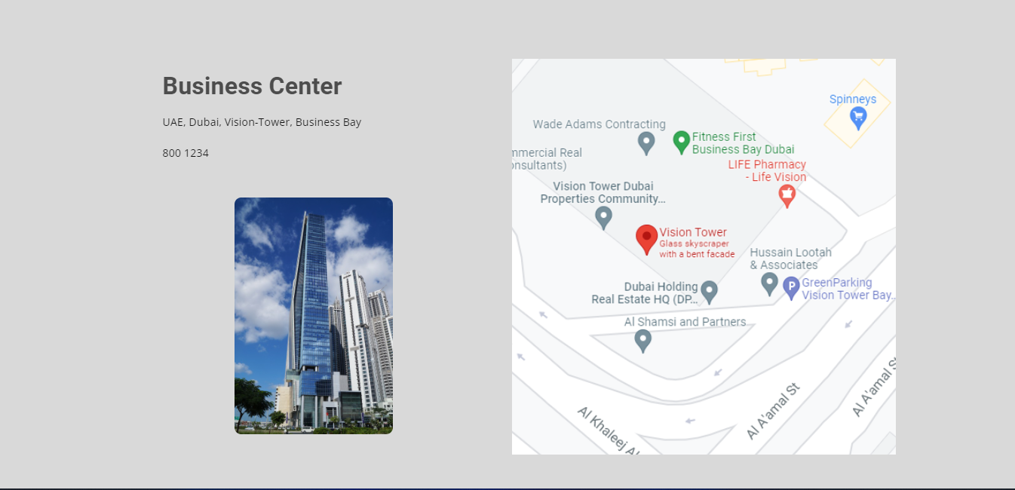
Share Our Office location to our customers
Dear Judges, do note that this is also used only as a reference location for the competition

Slide 16


Link will be sent shortly
Check our Website right away
This Photo by Unknown Author is licensed under CC BY-NC

